Slide 1
Comparative Analysis of U-Net Models Using ResNet34, InceptionV3 and VGG16 for the Processing of Satellite Images
Paper ID : 172
Track No. : Track 3 (S3)
All authors Name and Affiliation
Sushil Kumar, Anubhav Yadav, Ajay Varshney, Aayush Sharma, Shivani, KIET Group of Institutions
Presented by
Anubhav Yadav, KIET Group of Institutions

Slide 2
INTRODUCTION
Our main aim to apply Deep Learning models to Satellite Images
We are applying this for image segmentation process
To identify the land cover and land use pattern
For applications of remote sensing, solution to environmental monitoring, disaster management, etc
Uses the UNet Architecture

Slide 3
UNet ARCHITECTURE
It is CNN based neural network model
Has unique U-shaped structure, comprising an encoder, bottleneck and decoder component
It initially developed for bio-medical image segmentation
Utilized as a powerful tool for satellite imagery analysis in this paper
We used variants of UNet, namely ResNet34, InceptionV3 and VGG16

Slide 4
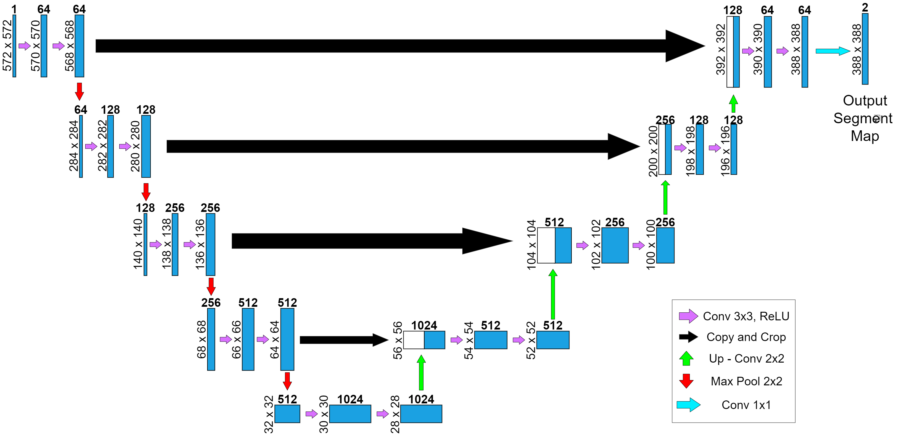
UNet ARCHITECTURE

Slide 5
METHODOLOGY
Data Collection: splits into two categories training and validation sets
Preprocessing: Resizing, normalization, augmentation, One-Hot Encoding, Data Patching, Data generation
Model Selection: Unet
Model Tuning: Configured with Adam optimizer and a custom loss function
Model is tuned and evaluated on the basis of following metrics: Intersection over Union (IoU), F1-score, Accuracy

Slide 6
EXPERIMENTAL SETUP
Our dataset comprises of high-resolution satellite images representing urban areas, rural landscapes, agricultural regions and natural environments
These dataset also ensures the diversity across various land cover types and geographical conditions.
Dataset contains about 1100 images.

Slide 7
EXPERIMENTAL SETUP
We splits the dataset into three subsets:
Training set (70%)
Validation set (15%)
Testing set (15%)
Before training, the dataset undergoes resizing, normalization, and augmentation for UNet compatibility, convergence and enhanced model resilience

Slide 8
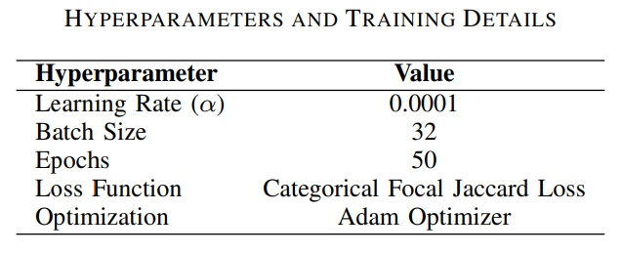
EXPERIMENTAL SETUP
Models undergo comprehensive training, incorporating crucial components such as hyperparameters, loss functions, optimization algorithms, data augmentation, and transfer learning. The training process is summarized in Table

Slide 9
EXPERIMENTAL SETUP
Originally trained on ImageNet, this approach accelerates convergence and improves feature capture for satellite images
In this research deep learning models benefit from carefully tuned hyperparameters, a customized loss function, the Adam optimizer, data augmentation, and transfer learning

Slide 10
RESULT ANALYSIS
The experiments were run for 50 epochs, the results recorded for each model
ResNet34 performed better than InceptionV3 and VGG16
Highest F1 scores is 0.6453 in training and 0.6455 in validation phases
This indicates a balanced precision and recall
Training accuracies were 84.84%

Slide 11
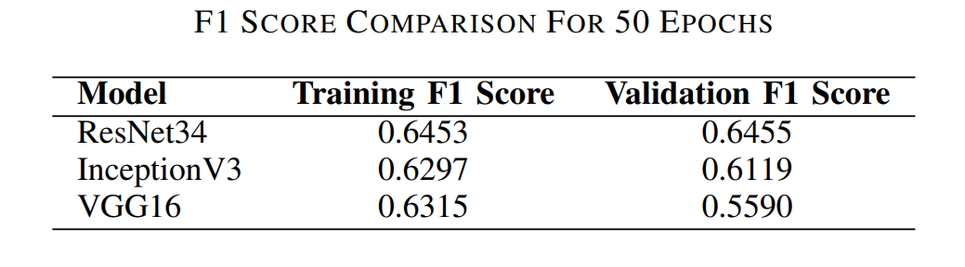
RESULT ANALYSIS
ResNet34 is resilient at identifying complex patterns.
Other models training and validation data is given in the table

Slide 12
RESULT ANALYSIS
ResNet34 model regularly exhibited a progressive decline in loss, which suggests successful learning and convergence
InceptionV3 model exhibited a little elevated although consistent loss over the training epochs
VGG16 model demonstrated a persistent trend of diminishing loss over the duration of the experiment

Slide 13
CONCLUSION
UNet based ResNet34, InceptionV3, VGG16 are trained and their efficiency are measured and analyzed
UNet based ResNet34 achieved the highest accuracy of 84.84% and validation score of 0.6455 after 50 epochs
ResNet34 is the model of choice for our particular task because it strikes balance between high precision, recall and accuracies and offers insightful information

Slide 14

Thank You

